Slide 1
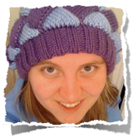
What to do after the Tutorial
Kelsey Karin Hawley
@kkarinhawley
Software Engineer @ Honor

Slide 2
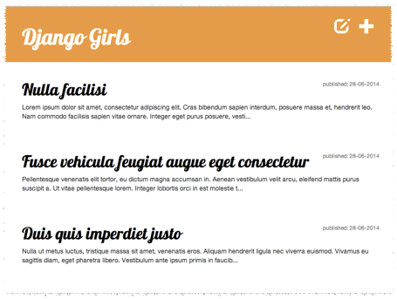

Finished DjangoGirls Tutorial!
Django installed
Models + ORM
Admin site
Beautiful CSS
First Blog Post

Slide 3
Now what?

Slide 4
New Project?
Notes:
Project Based Learning - some cool idea to build from scratch

Slide 5
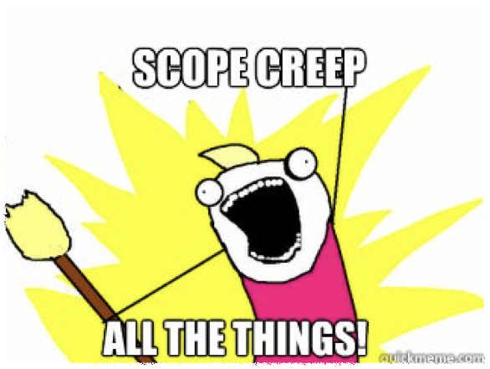
Massive Undertaking
Notes:
Beware of Scope Creep - Don't let one cool idea evolve into 50 awesome features that you can't tackle or prioritize

Slide 6
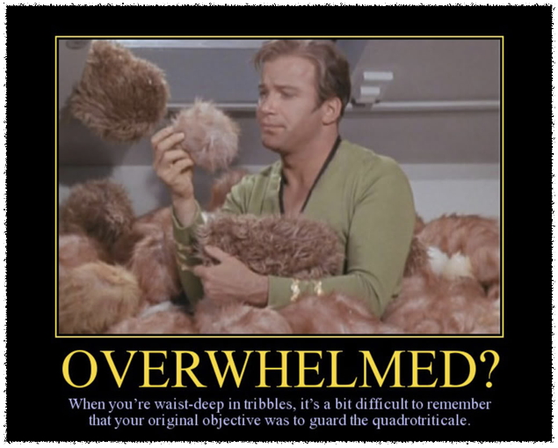
Massive Undertaking
Notes:
Scope Creep can leave you feeling overwhelmed, unproductive and disillusioned

Slide 7
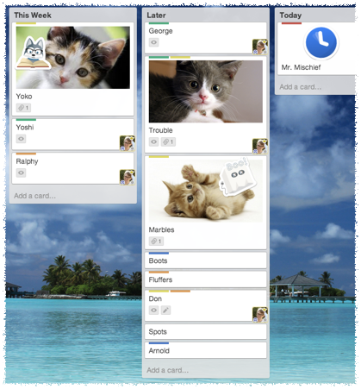

Project Based Learning
Break into pieces
Notes:
And prioritize them

Slide 8
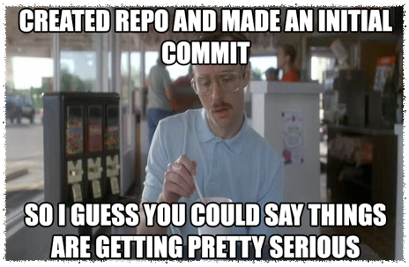
Project Based Learning
Break into pieces
Work smaller
Notes:
Small accomplishments are very satisfying and can keep you motivated

Slide 9
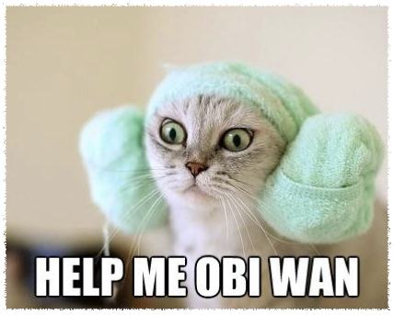
Project Based Learning
Break into pieces
Work smaller
Ask for help
Notes:
Don't be afraid to ask for help when you need it

Slide 10
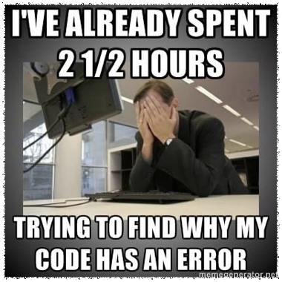
Project Based Learning
Break into pieces
Work smaller
Ask for help
Don’t get discouraged
Notes:
We've all been there, with a tough problem or an unruly bug. But it gets better

Slide 11

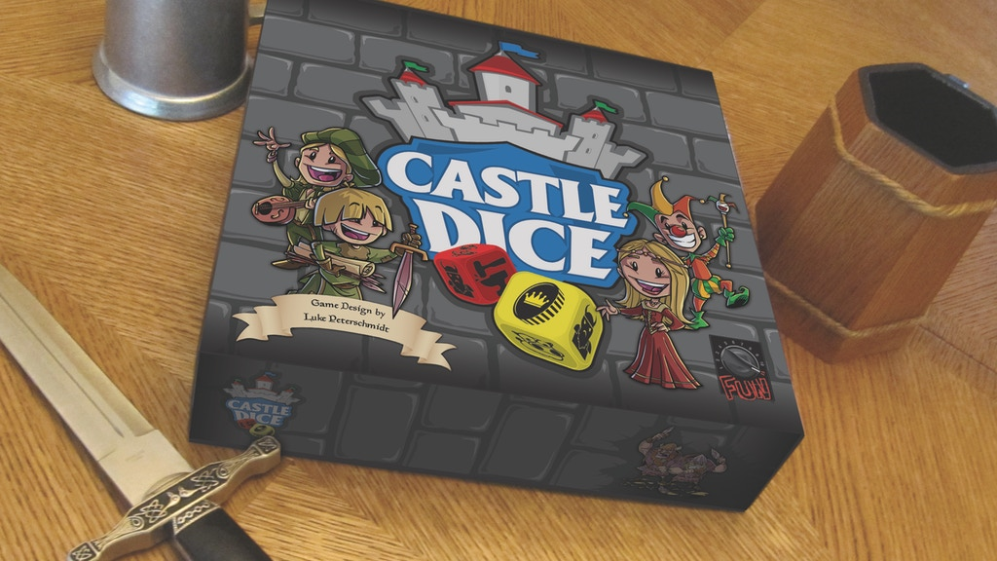
Notes:
Cool game called Castle Dice that I love

Slide 12
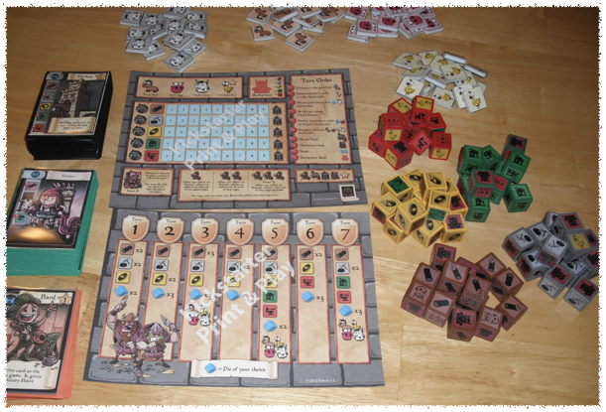
Notes:
Lots of pieces - all the dice, trackers, multiple decks, trackers for trackers...
And one day I decided to make this game into a Django app to play with my remote friends

Slide 13
The
Horror
Notes:
I had my work cut out for me

Slide 14
So... Is it done?

Slide 15
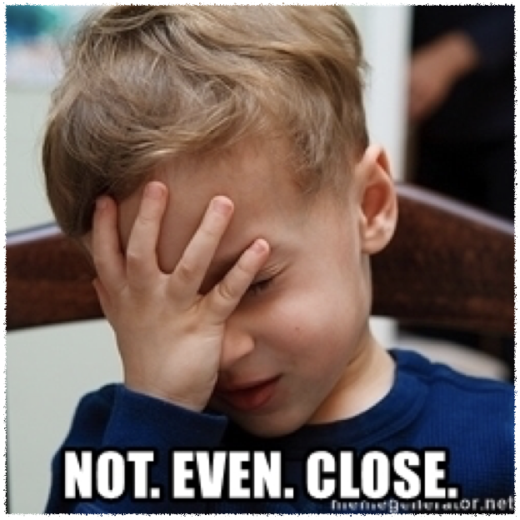
Notes:
Heck no!

Slide 16
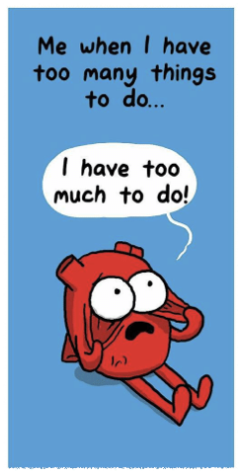
Nuggets of Wisdom
HUGE project
Notes:
Snippets of wisdom to share:
Started with a huge project, bit off more than I could chew.
Should have chosen something with a smaller MVP

Slide 17

Nuggets of Wisdom
HUGE project
Lots of unknowns
Notes:
I still don't know game mechanics and logic. And I don't understand how to portray turn based mechanics in a web app

Slide 18
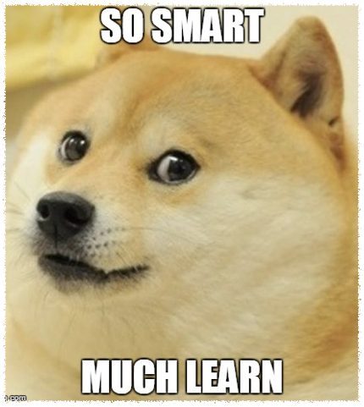
Nuggets of Wisdom
HUGE project
Lots of unknowns
I learned a TON
Notes:
But I learned more about Django and customizing for what I needed. And dug deeper into Python

Slide 19

Nuggets of Wisdom
HUGE project
Lots of unknowns
I learned a TON
I had fun
Notes:
Some parts work, and they're pretty cool

Slide 20
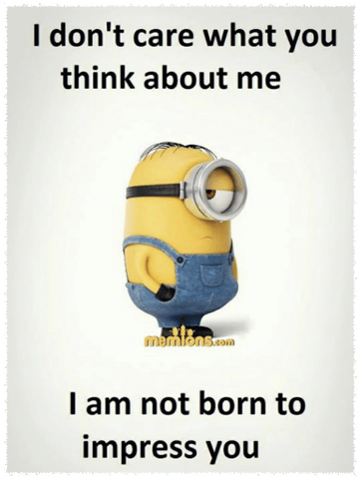
Nuggets of Wisdom
HUGE project
Lots of unknowns
I learned a TON
I had fun
Done? doesn't matter
Notes:
I don't care if its not done. And neither should you. I built this for me, to learn. Your judgements don't bother me

Slide 21
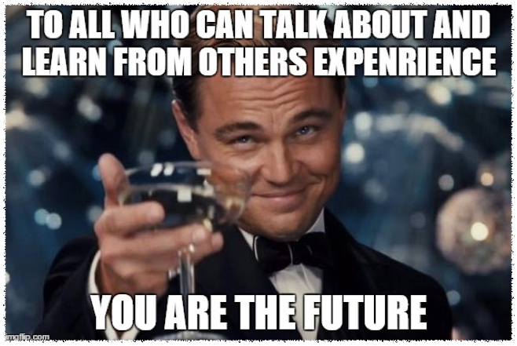
Learn Vicariously
Notes:
Some people do better learning from others

Slide 22
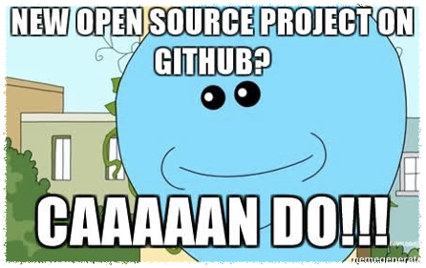
Observation based
Find a Django Project on Github
Break it down and dissect it
Is it easy to read?
What do you understand?
What is confusing?
Solve a bug
Notes:
Take a look at what have other Django Girls Projects have become

Slide 23
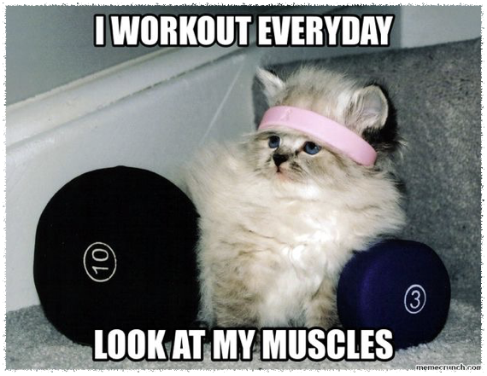
Repetitive Challenges
Notes:
Others want a set of small problems and solutions they can do quickly

Slide 24

Exercise Based Learning
HackerRank
CodeFights
CoderByte
CodeWars
Project Euler
CodinGame
CodeEval
TopCoder
CodeCombat
CodeChef
HackerEarth
Spoj
DevDraft
99 Problems
Exercism.io
Rosalind
CodeKata
Programmr
Timus
LeetCode
CodeForces
Notes:
Two of my favs - HackerRank + exercism.io

Slide 25
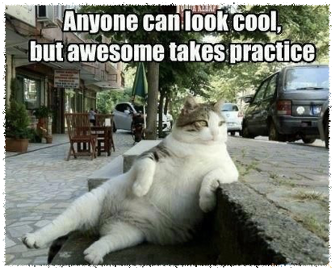
Exercise Based Learning
Pick one that looks good
Pick one that gives feedback
Practice
Keep doing the challenges
Notes:
More toward language building and not tools, like Django
- but good for Python + Javscript

Slide 26
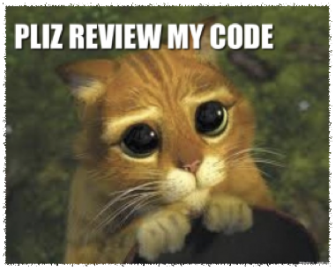
Get Connected
Meetup Groups
Conferences
Mentor
Friends
Coworkers
StackOverflow
Notes:
Most important!
Come with your problems, ask lots of questions, reach out

Slide 27
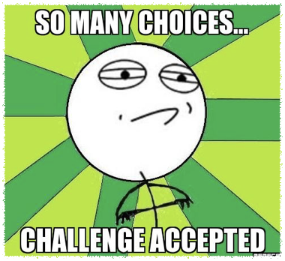
How do you learn?
Project based
Exercise based
Observation based
Notes:
Mix + Match, Try them all, Collect the set!

Slide 28

Learn your way

Slide 29
Resources
Me - @kkarinhawley, Honor (joinhonor.com)
These slides (and more) at gitHub.com/khawley/my-talks
Long form of this talk (less gifs) https://youtu.be/5unbeTDbjuE
My crazy project - Castle Dice gitHub.com/khawley/CastleDice

